Slide 1
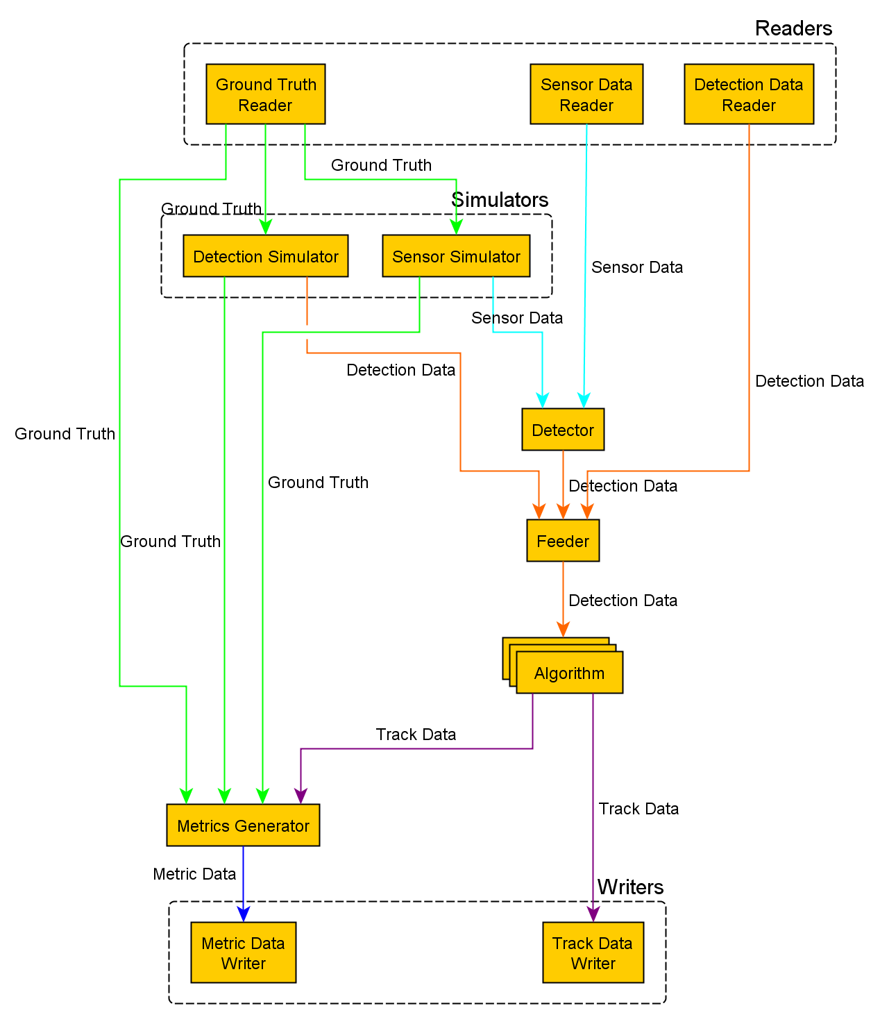
“ I want to use a Detection Simulator ”
Lets just assume we want both of these outputs.

